Slide 1
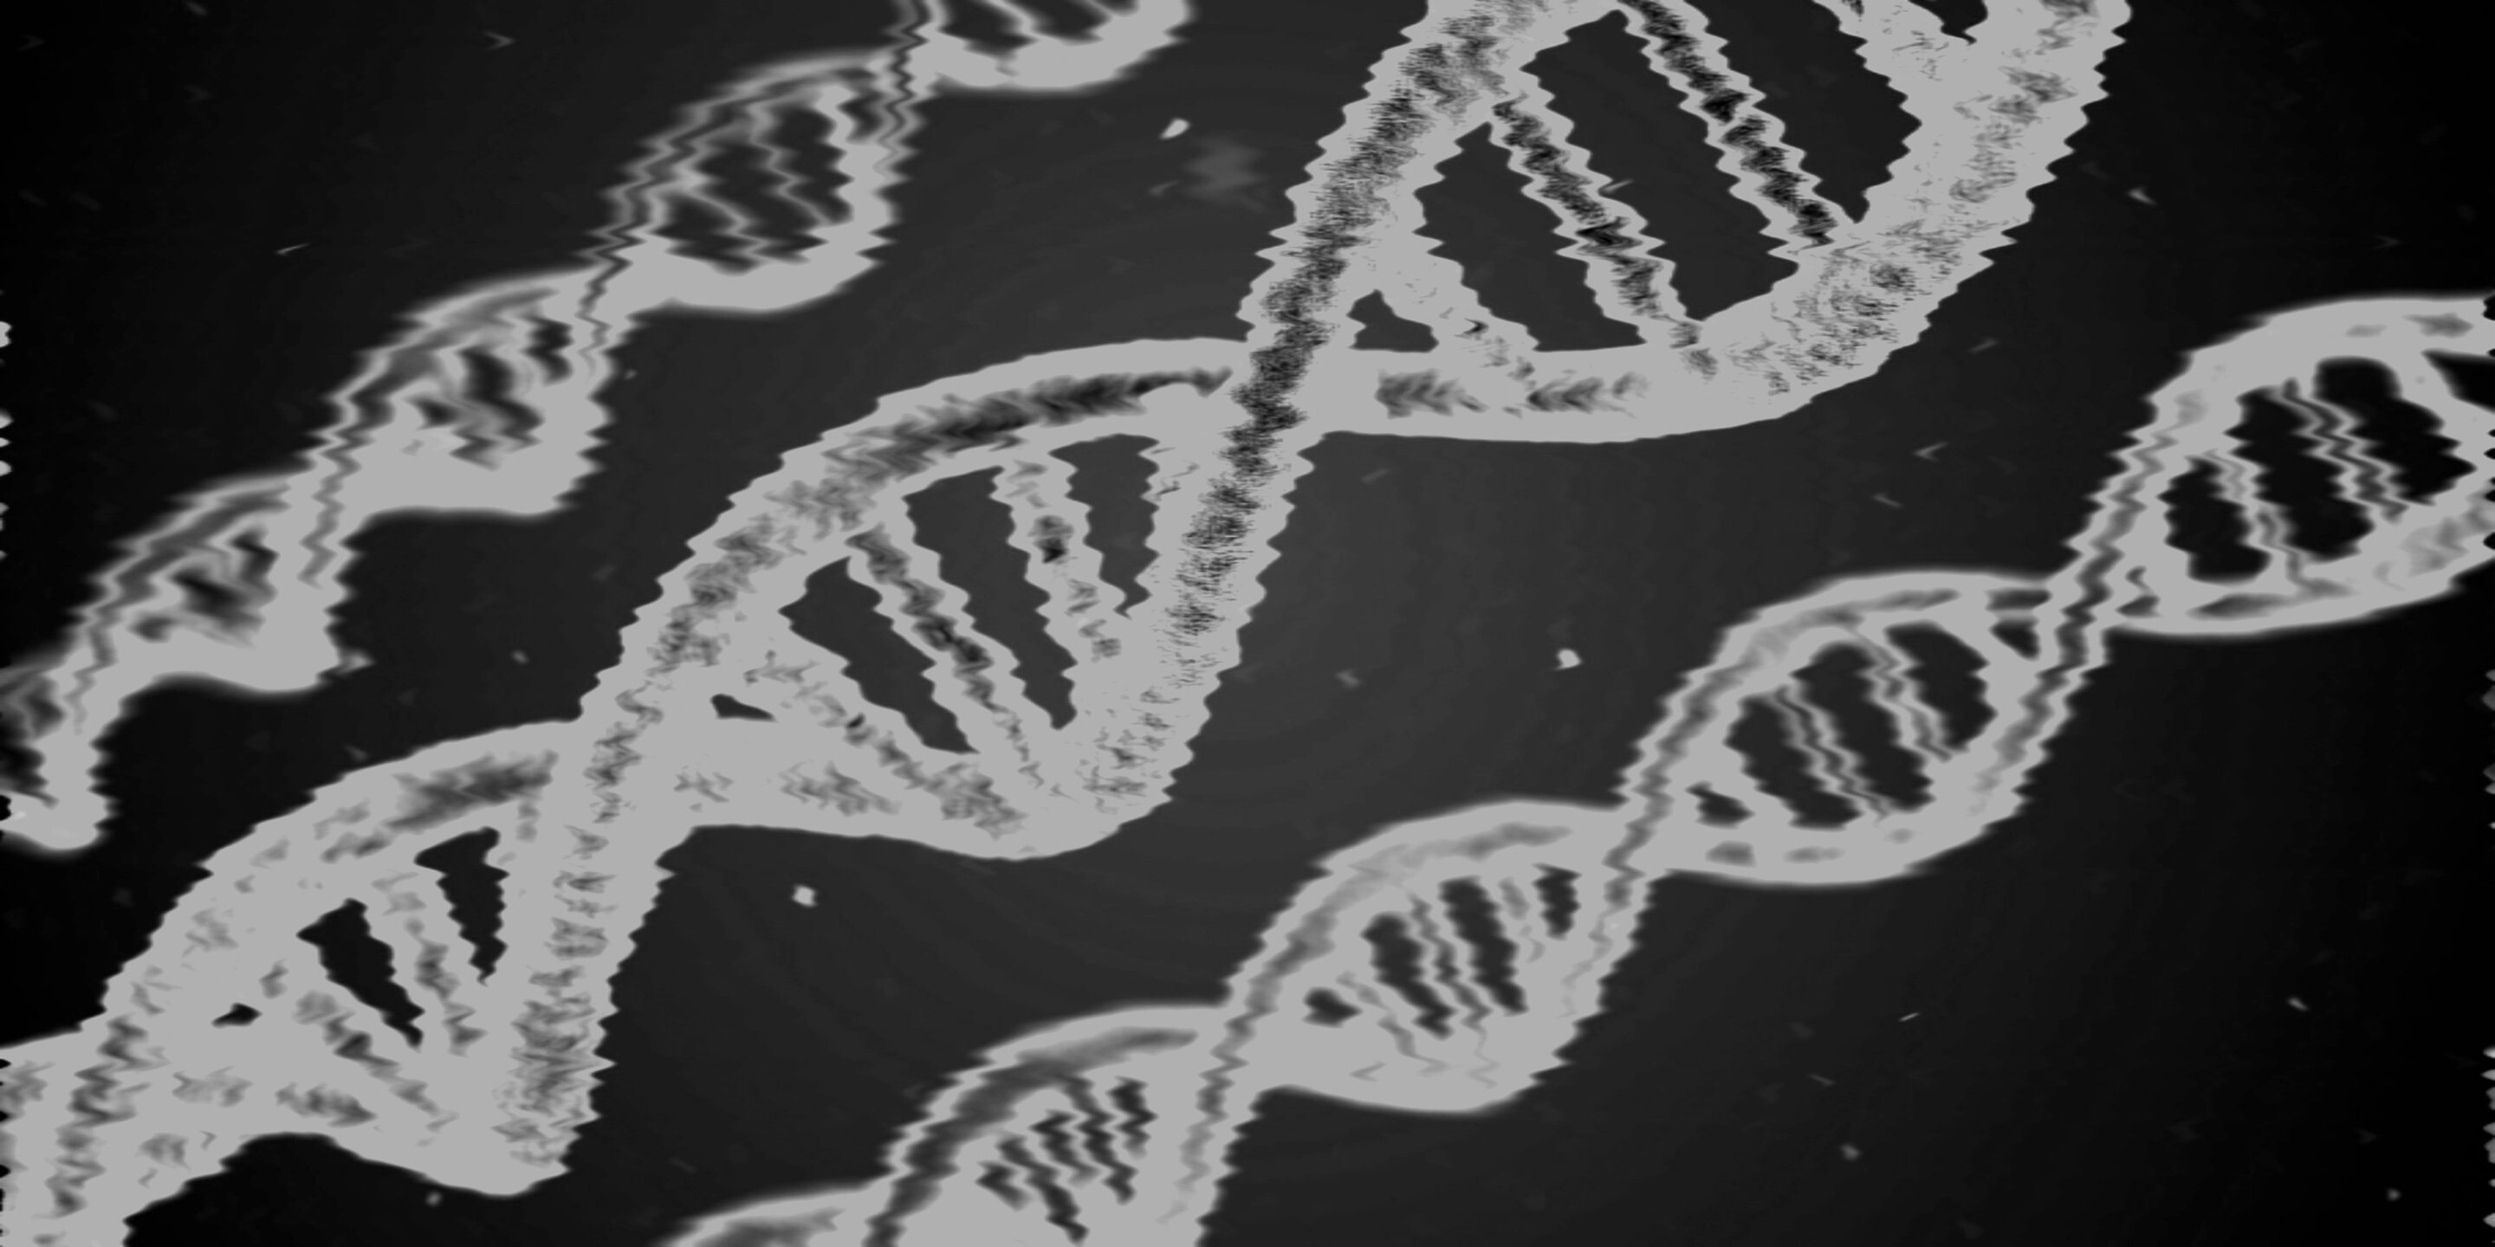

UNIVERSITY OF NOTRE DAME
Identifying Breast Cancer with Machine Learning
Case Study by Aldo, Avisek, & Kait

Slide 2
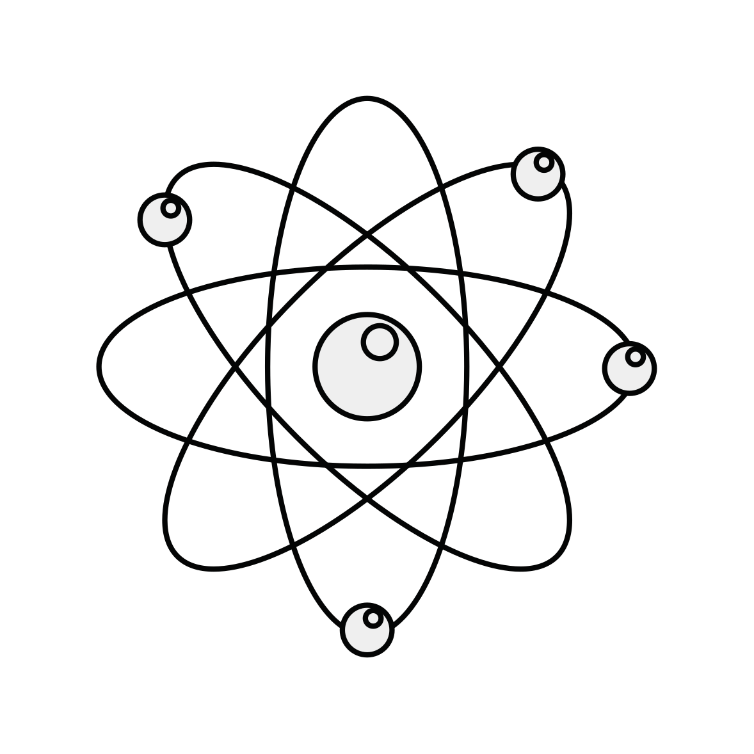
LIST OF KEY CONCEPTS
Using machine learning techniques to assist in identifying malignant tumors
Findings:
Kth Nearest Neighbors
Decision Trees
Random Forests/Bagging
Conclusion
Our Agenda for Today

Slide 3
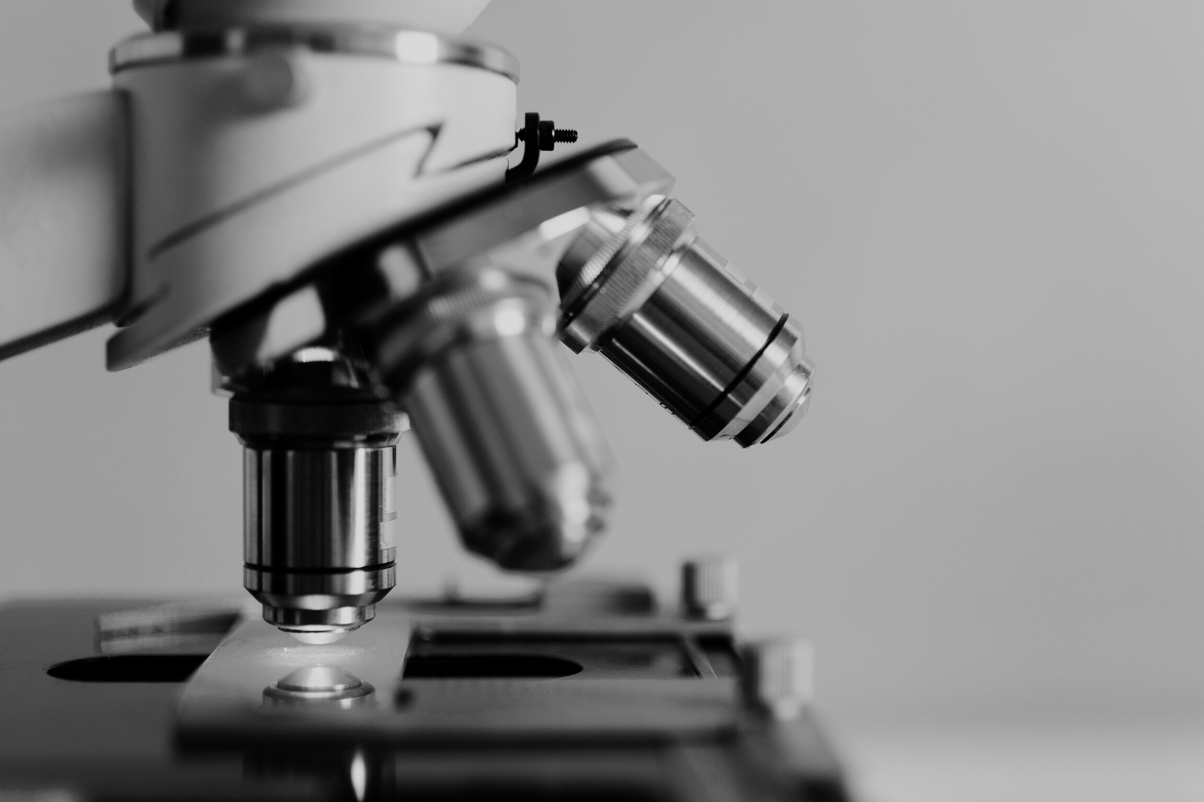
What is
machine learning?
COMPUTER GUIDED DECISION MAKING
Machine Learning is a set of methods which enables the computer to make decisions or infer conclusions without us guiding it.
Notes:
What is Machine learning?
One definition is simply that it is computer guided decision making.
That is to say, Machine Learning is a set of methods which enables computer to make decisions or infer conclusions based upon a set of input data. These inferences can be made without human intervention.

Slide 4
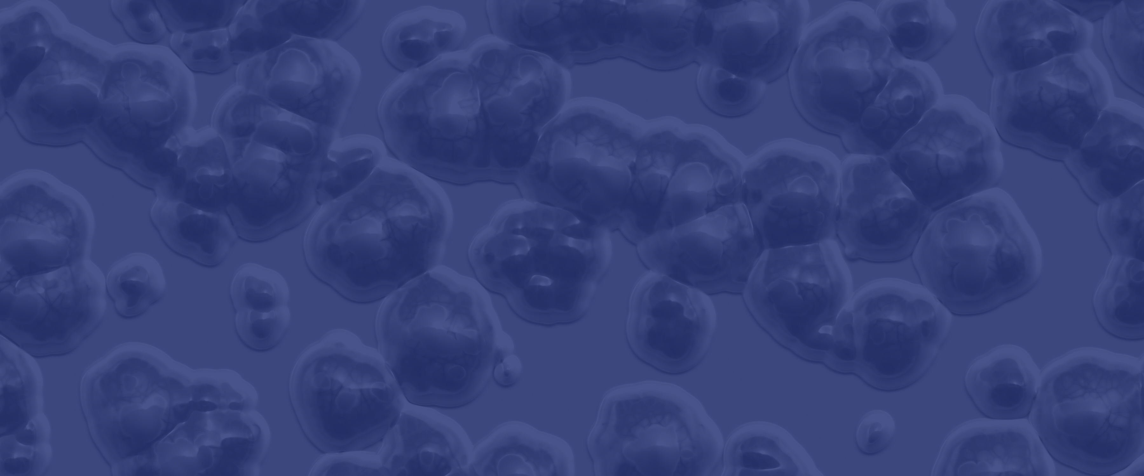
"...AI [and machine learning] will not replace doctors, but instead will augment them, enabling physicians to practice better medicine with greater accuracy and increase efficiency. "
Benjamin Bell
Notes:
A question that is frequently raised is, “what is the role of machine learning in the medical field?” It is perhaps best summarized by this quotation from Benjamin Bell, a researched at John Hopkins University.

Slide 5

Just like a human, a computer can learn from 3 sources.
How a computer learns:
One | Supervised
Observing what others did in similar situations
Two | Unsupervised
Observing a situation and trying to devise the best possible logic on the spot to decide/conclude
Three | Reinforcement
Learning from previous mistakes/success.
Notes:
How does a computer learn? There are three broad categories that answer this question.

Slide 6
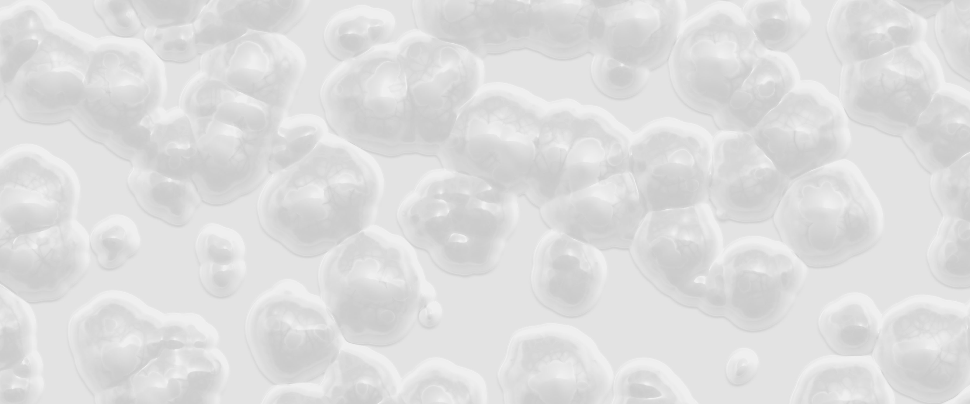
OUR FOCUS
Supervised Learning Techniques:
Kth Nearest Neighbors
Decision Trees
Random Forests/Bagging

Slide 7
Overview of Classification Techniques
Decision Trees
Kth Nearest Neighbor
Random Forest/Bagging
Simply a set of cascading questions. One uses each attribute (i.e. a value of a given feature of the data point) to answer a question. The answer to each question decides the next question. At the end of this sequence of questions, one will end up with a probability of the data point belonging to each class, or in this case, diagnosis.
A form of pattern recognition, in which one associates what one is trying to classify with other values that are the closest/most similar to it, calculating the distance between points. The key assumption of the KNN algorithm is that that similar things exist in close proximity.
A model made up of many decision trees and each tree learns from a random sample of the data points. The concept of bagging implies that some samples will be used multiple times in a single tree. The predictions are made by averaging the predictions of each decision tree.

Slide 8
Application of Algorithms in Diagnosis Prediction
Random Forests
Decision Trees
Kth Nearest Neighbor
• Determining the species of an animal
• Determining the species of an animal with multiple decision trees
• Behavioral segmentation by purchase history
e.g. Consumer A's purchase behavior resembled consumer B, so we will assume they will make purchases similar to Consumer B in the future
e.g. Species 1 can be determined by a series of attributes and Species 2 has a different series of attributes.
e.g. Take the example used for Decision Trees & picture 500 trees each created by randomly sampling the data
Notes:
To understand the application of algorithms in diagnosis prediction, it is useful to examine some examples of how each algorithm works:
Kth Nearest Neighbor – behavioral segmentation by purchase history.
There are two supermarkets in a town. Most people in a certain neighborhood do their grocery shopping at the supermarket right down the road (Supermarket A). The other (Supermarket B) is a few miles away. A new family moves into that same neighborhood. They would most likely do their shopping at Supermarket A, as most of their neighbors do.
A thought about how to describe decision trees for the video – it’s kind of like the game of twenty questions.
In a way, it is like playing a game of twenty questions.
Is it bigger than a microwave oven? Yes
Does it have fur? Yes
Do you see it a zoo? No
And so on…
At each step, the number of possible outcomes is reduced.
At the end, a guess or prediction of the species of animal can be made.
Random Forests
To continue the analogy of the game of 20 questions from the Decision Tree example, imagine playing the game repeatedly, each time trying to answer the same question. At the end, the output of all iterations of the game is used to make a prediction about the species.

Slide 9
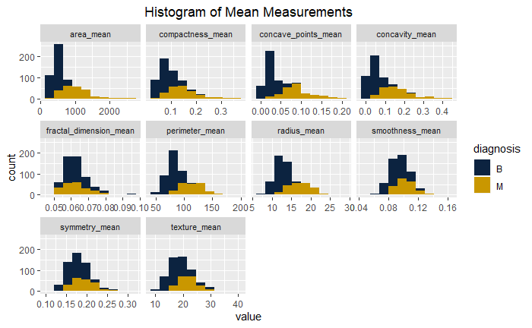
Mean Measurements
OUR FINDINGS:
In some of the mean histograms, we see vast differences between the distributions for benign and malignant tumors (blue and gold, respectively). For others, the distributions are relatively similar.
For example, the area_mean chart has vastly different distributions for the blue and gold data, which signifies that the mean values for area_means may useful in discerning benign vs. malignant.
Notes:
From these plots, we can also see the ranges of each variables. This helps us understand the data better and also get an understanding of the variability within each variable.
For the data set we analyzed, there were 10 characteristics for cell nuclei. For each of these characteristics, various measurements were recorded. Our analysis focused on the mean measurements for these 10 characteristics. As part of our exploratory data analysis, we generated histograms for each characteristic to illustrate the distributions of these measurements. In some of the histograms, we see vast differences between the distributions for benign and malignant tumors (blue and gold, respectively). For others, the distributions are relatively similar.
As an example, the area_mean chart, which analyzes the distribution of mean or average area of cell nuclei, clearly has different distributions for the blue and gold data. This signifies that the mean values for area may useful in discerning benign vs. malignant.

Slide 10
According to the Random Forest algorithm,
The most powerful predictors are...
CONCAVE POINTS MEAN
PERIMETER MEAN
CONCAVITY MEAN
*This has been calculated using the importance() function in R.
Notes:
Talking Point: expand upon importance() function and how we are used this for bagged tree/random tree and we also used these importance rankings as a guiding principle for what to focus on for our introductory section, the exploratory data analysis.
A series of slides detailing the results of the exploratory data analysis follows.
The random forest algorithm has a concept called importance, which orders the variables based on their predictive power. We use this information as a convenient way of ordering the following slides containing more details about the results of our exploratory data analysis.

Slide 11
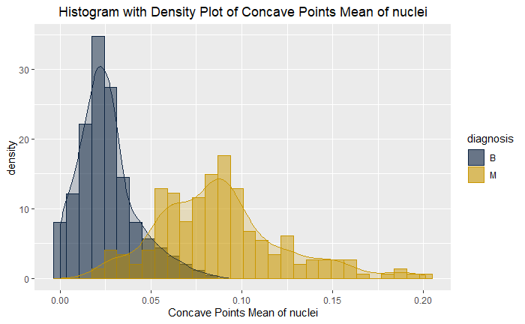
The Tumor’s:
Likely candidate predictor 1
Concave Points Mean
Vastly different distributions for the benign and malignant.
Notes:
As previously explained, we focused our exploratory data analysis on our ”most important” predictors as determined by the random forest algorithm. Here we can see the vastly different distributions for the benign and malignant tumors, and we can also see the ranges for each. For example, the concave points mean for benign tumors ranges from about 0 to 0.1, whereas the malignant tumors range from about 0 to 0.2.
These plots provide a means of visualizing the distinct differences in distributions of characteristics for benign and malignant tumors. Understanding which values are most useful in determining whether a tumor is benign or malignant can help focus one's efforts. Our analysis, based upon a lengthyand rigorous advanced analytical study, will by no means replace the need for human’s reading of the tumor scans, but rather equip a medical professional with more information in assessing whether a tumor may be benign or malignant.
These plots are useful in understanding the data in a way you might not be used to looking at it, comparing the values for benign tumors versus malignant. These plots should help you determine what to pay attention to in reading your charts and the different thresholds you may set to determine if benign or malignant. Our analysis will by no means replace the need for human’s reading of the tumor scans, but rather equip the Xray reader with more information in assessing whether a tumor may be benign or malignant based upon a length and rigorous advanced analytical study.

Slide 12
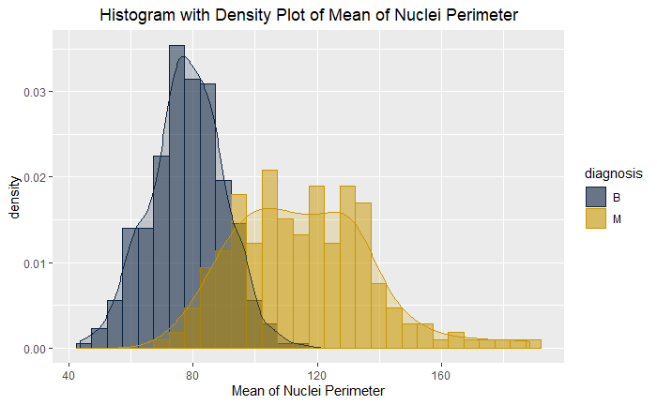
The Tumor’s:
Likely candidate predictor 2
Mean of Nuclei Perimeter
Vastly different distributions for the benign and malignant.
Notes:
Much like the previous slide, the Nuclei Perimeter Mean for Benign and Malignant tumors have very different distributions. One can see a sharp peak for in the benign cell observations, whereas one sees a lower, more spread out distribution of the malignant cell observations.

Slide 13
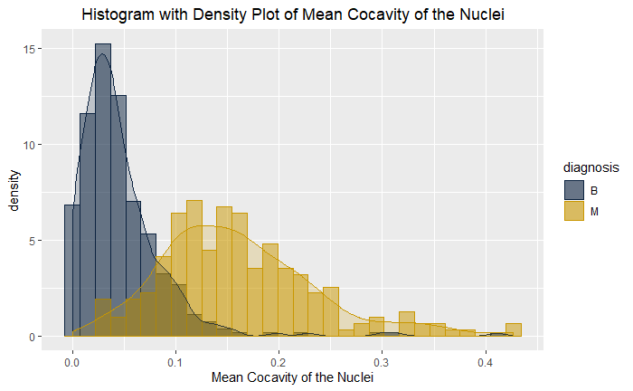
The Tumor’s:
Likely candidate predictor 3
Mean Concavity of Nuclei
Vastly different distributions for the benign and malignant.
Notes:
The same is true of the Concavity of Nuclei mean shown on this slide. Distinct distributions for Benign and Malignant can be seen.

Slide 14
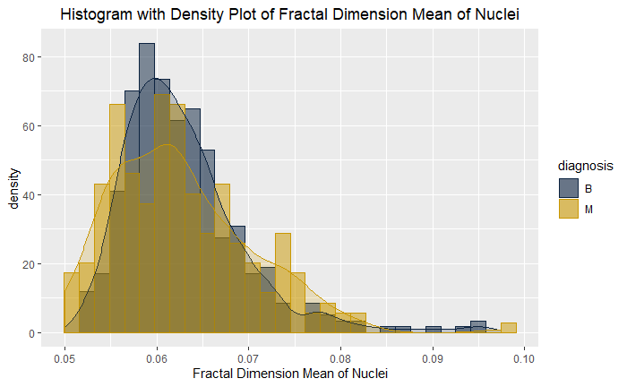
The Tumor’s:
Not a likely candidate predictor
Mean Fractal Dimension of Nuclei
Very similar distributions for the benign and malignant.
Notes:
In contrast to the previous examples, the Fractal Dimension of Nuclei shows almost a total overlap in the distributions of mean for benign and malignant. This characteristic may not be as important as the previous three in determining whether a given cell is benign or malignant.

Slide 15
Takeaways from Exploratory Data Analysis
Our interpretation of how this information should be utilized by physicians
Variables with visibly distinct distributions for malignant and benign, such as the three highlighted earlier, should be the primary focus in determining a diagnosis.
Note the ranges of each of these variables, especially the range in which 95% of the observations fall for each variable.
Other variables such as Fractal Dimension of Nuclei, whose distributions show a high degree of overlap, may not be as statistically significant in predicting a tumor’s diagnosis and thus may not merit close inspection.
Notes:
Is the interpretation that the 5 variables should be used by the doctors or by the machine learning algorithms or both?
When viewing the details of the medical reports, the five characteristics listed earlier should receive the highest priority in determining malignancy.
Note that the range of each of these five variables. Pay special attention to the range in which 95% of the observations fall for each of the variables.
Those variables not in the top five may not require as much attention; these variables were determined to have less statistical significance in determining whether a tumor is benign or malignant.

Slide 16
OUR FOCUS
Supervised Learning Techniques:
Kth Nearest Neighbors
Decision Trees
Random Forests/Bagging
Notes:
Back to our focus and the algorithms we used to help classify these tumors as either benign or malignant. We will go through each algorithm at a high level and the main findings/learnings from each. If you have any further questions after our high-level findings, don’t hesitate to reach out.
Before we dive into the details of each analysis, we want explain the rescaling we did in the data preprocessing step before we modeled the data. We used the min max function. This methodology is commonly called feature scaling or data normalization. It is used to normalize the range of independent variables or features of data.
Next, we will discuss the details of the supervised learning techniques we analyzed. Before beginning that topic, we wanted to highlight that the data was rescaled prior to the analysis. Rescaling the data prevents from those variables with high magnitude values from dominating the machine learning process. All variables are put on the same scale. In our case, we used the min/max function, which is a common means of rescaling or data normalization.
More on the min max function: rescale_x <- function(x){(x-min(x))/(max(x)-min(x))}

Slide 17
Kth Nearest Neighbor
Methodology: The Kth nearest neighbor utilizes Euclidean distances to determine the closest points to our test data point. It uses the methodology that similar tumors (those with similar values for each variable) will produce a similar diagnosis. Our final model has been optimized with fine tuning of each input to the model.
Key Takeaways: Our model predicted benign or malignant tumors with the highest accuracy of all models, 92.98%. Our rate of misclassifying a benign tumor as malignant was 2.7%, which was lower than our rate of misclassifying a malignant tumor as benign at 9.1%
Notes:
We'll use the Kth Nearest Neighbor to classify the diagnosis. The KNN approach is a lazy learner, which means that it will predict values in a test data set based upon distances from values in a training data set without creating a model. For a given point in the test data, we calculate the distance of all the predictors from the Kth nearest neighbors in the training data. If the majority of the nearest neighbors are benign (B), then our test data point is classified as B. If of the other hand, most neighbors are malignant (M), then our test data point is classified as M. We use odd numbers as values for K; even values of K could result in a tie, which would might cause random results. To begin, we choose a value of K that is equal to the square root of n, the number of rows in our training data set. Then we show the overall accuracy of the classifier with this value of K as well as the misclassifcation rate for M as B and B as M.
We will use the caret package "train" function to see if a diffent value of K results in higher accuracy. This code block will step through odd numbers from 1 to 99 as values of K. If a better value of N is found, then we will use that value instead. K=9

Slide 18
Decision Trees
Methodology: Use decision trees to predict the diagnosis of the tumor using the metadata of the tumor. Use a data science technique called pruning to reduce the complexity of the final classifier and reduce overfitting. Overfitting is when we fit the model too closely to our sample data and the model will be inaccurate if used on new data.
Key Takeaways: Our model predicted benign or malignant tumors with a 90.4% accuracy. Our rate of misclassifying a benign tumor as malignant was 10%, which was slightly higher than our rate of misclassifying a malignant tumor as benign at 9.5%
Notes:
The Decision Tree algorithm belongs to the family of supervised learning algorithms; it can be used for solving both regression and classification problems. The general motivation for using a decision tree is to predict the class or value of target variables by learning decision rules inferred from prior data (the training data). The decision tree algorithm tries to solve the problem, by using a tree representation. Each internal node of the tree corresponds to an attribute and each leaf node corresponds to a class label.
In R there are several packages available to run the decision tree algorithm. Here we'll use ` rpart` package and also `caret` package implement the decision tree with cross-validation.
Pruning is a technique in machine learning and search algorithms that reduces the size of decision trees by removing sections of the tree that provide little power to classify instances. Pruning reduces the complexity of the final classifier, and hence improves predictive accuracy by reducing overfitting.

Slide 19
Random Forest
Methodology: Random forest takes the decision tree a step further by creating a large number of individual decision trees which each generate their own class prediction. The class with the most votes becomes our model’s prediction. It is a more powerful use of the decision tree. Our final model has been optimized with fine tuning of each input to the model.
Key Takeaways: Our model predicted benign or malignant tumors with a 92.1% accuracy, which is slightly better than with our simple decision tree. Our rate of misclassifying a benign tumor as malignant was 7.5%, which was slightly lower than our rate of misclassifying a malignant tumor as benign at 8.1%
Notes:
Random forest, like its name implies, consists of a large number of individual decision trees that operate as an ensemble. Each individual tree in the random forest generates a class prediction, and the class with the most votes or mean prediction of the individual trees becomes our model’s prediction. The fundamental concept behind random forest is a simple but powerful one — the wisdom of crowds.
We create a random forest using the package ` randomForest` to be used as a basis to predict diagnosis. The forest is set up so that there will be 500 trees and 3 variables will be tried at each split.
It should be noted that the Random Forest yielded the lowest rate of misclassifying a malignant tumor as benign.

Slide 20
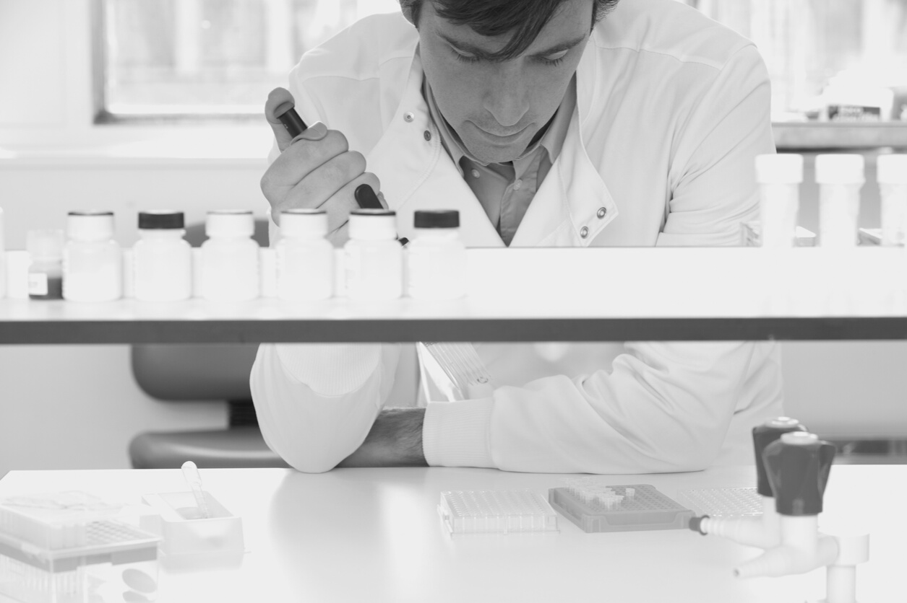
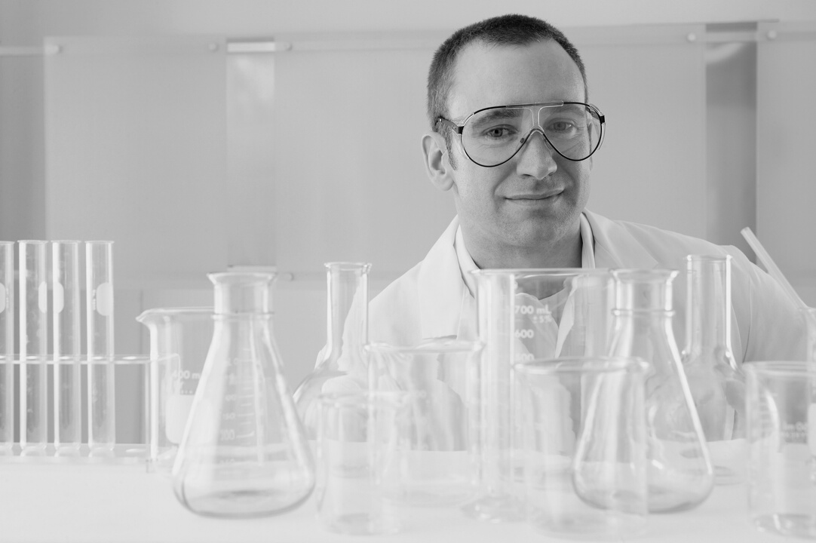

Main Findings
1. The Kth Nearest Neighbor provided the highest overall accuracy
We recommend “productionalizing/productizing” the Kth Nearest Neighbor Model that had the highest accuracy of 93%.
2. The Random Forest Model provided the lowest misclassification rate of malignant tumors as benign.
The Random Forest provided us with a misclassification rate of 8.1% for malignant tumors as benign. We also recommend “productionalizing/productizing” the Random Forest and using a combination of the two machine learning techniques.
3. Our Error Rate is less than 10%
While we optimized and fine tuned our analysis as much as possible, our error rate was still ~7% when using the Kth Nearest Neighbor and we saw an ~8% misclassification for malignant as benign using our Random Forest model. As the algorithms continue to learn from the tumor data, we anticipate a decrease in our error rate and retuning the analysis may be required.
Notes:
Just want to point out that while the KNN algorithm did in fact have the highest accuracy overall, it did misclassify more malignant tumors as benign than the Random Forest did.

Slide 21
Risks of Machine Learning
False Negatives vs False Positives
It is important to note that misclassifying a malignant tumor as benign is worse than misclassifying a benign tumor as malignant. This misclassification rate must be taken into consideration when evaluating the effectiveness of a machine learning technique. We anticipate that we will be able to lower this misclassification rate as more data is made available from which the machine learning algorithms can learn.
Notes:
I just want to point out that there is no model for KNN, so adding more data won’t necessarily help with the misclassification rate for that technique. For Decision Trees and Random Forests, more data may indeed be of benefit.

Slide 22

Further Learnings
The accuracy will improve as we collect more data
Human intervention is still needed.
As previously noted, these predictions should be used to supplement the manual analysis of these tumors from the graphical imaging software. The process of FNA will still be required, as will the photography of the extracted cells under a microscope and the process of the trained technician to record the measurements.

Slide 23


Sources of our Research
https://medium.com/@kuthayasankar/what-is-machine-learning-explain-like-i-am-5-year-old-a8f25aed703d
https://towardsdatascience.com/machine-learning-101-for-dummies-like-me-bdc6d03e1a38
https://amzn.to/2O2WWnj
https://towardsdatascience.com/understanding-random-forest-58381e0602d2

Slide 24



The team @
Notre Dame
Aldo Adriazola
Principal Member of Technical Staff @ AT&T
Avisek Choudhury
Business & Application Tech Specialist @ North Carolina State University
OUR IN-HOUSE
DATA EXPERTS
Kait Arnold
Analytics Engineer @ VSP Global

Slide 25
Contact Us
HOW TO REACH US
E-mail Addresses
aadriazo@nd.edu
achoudhu@nd.edu
karnold3@nd.edu

Slide 26
APPENDIX

Slide 27
GITHUB REPO
https://github.com/avisek2018/idsproject2020

Slide 28

“Machine Learning is the science of getting computers to learn and act like humans do, and improve their learning over time in autonomous fashion, by feeding them data and information in the form of observations and real-world interactions.”

Slide 29
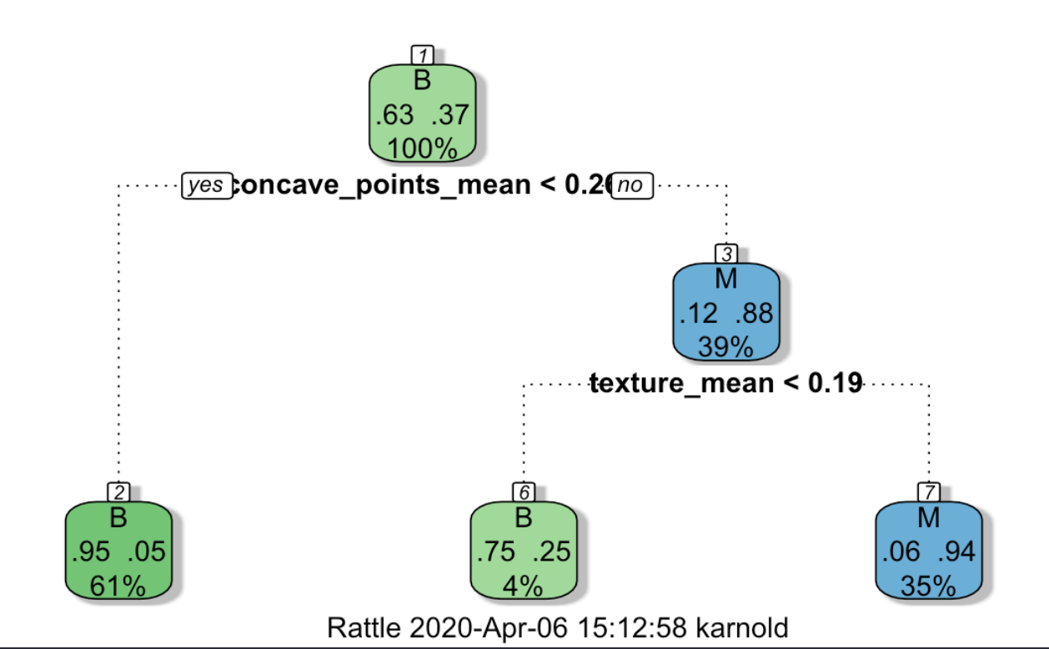
Decision Trees Output
Notes:
If we want to show this and the presenter can walk the audience through the output of this chart.

Slide 30
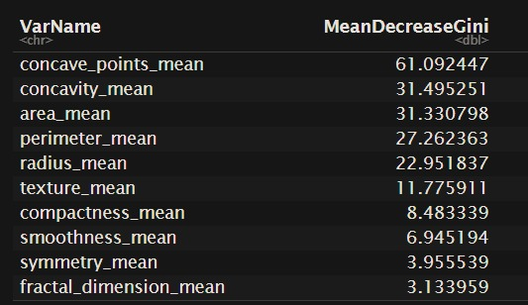
Importance() Output
Notes:
If we want to show this and the presenter can walk the audience through the output

